Slide 1

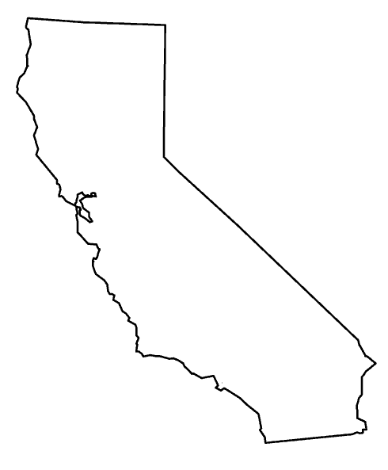

Machine learning in health care enforcement
Automatically estimating the size of a fine and the cause of a patient’s injuries from unstructured medical narratives

Slide 2
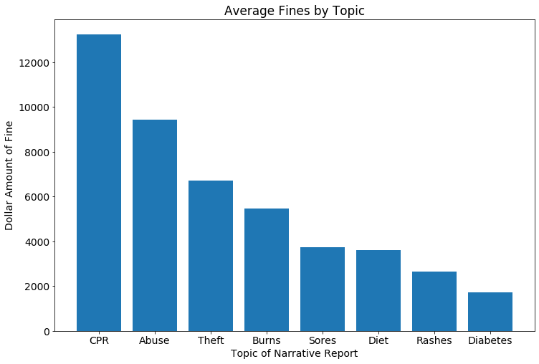
Executive summary
California’s DHCS provides 2,883 narratives of patient injury or death, each linked to a fine assessed against the patient’s hospital or nursing home.
Using machine learning techniques, I automatically identify the topic of each narrative and estimate the amount of the fine based on the unstructured text.
Incidents featuring cardiovascular emergencies or sexual abuse were associated with fines that are 5 times higher than incidents about diet or rashes.
The model was able to successfully predict 96% of the fines that were over $5,000, even though only 25% of the fines in the sample were this large.

Slide 3
DATA CLEANING AND EXPLORATION

Slide 4
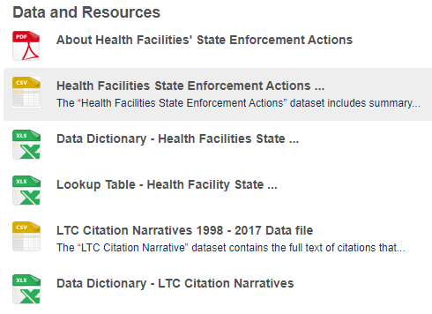
California open data portal
California’s Open Data Portal maintains all records of health care enforcement actions from 2012 – 2017
The data is available in .csv format and is generally very clean: 2,883 of 2,885 incident reports had text, fine amounts, and identifying data available.
The data was almost entirely machine-readable, with only minor adjustments needed – I converted text into dates and currency into numerals, but was otherwise able to build Pandas DataFrames directly from a merger of two of the .csv files.

Slide 5

Natural language processing
To improve the relevance of the long text narratives in the database, I parsed each document using Spacy’s natural language processing (NLP) tools.
Using the medium-size Spacy web corpus, I identified and removed ‘stopwords’ that carry little or no distinct semantic content, such as “the” and “for.”
I also removed punctuation, whitespace, words that consisted of nothing but numerals (e.g. 2017), and suffixes, leaving behind only meaningful root words.
There were 85,974 unique root words in the database. The most common word was “resident,” which appeared 93,195 times.

Slide 6
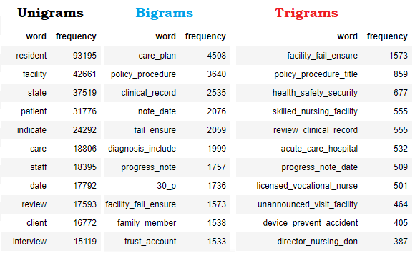
Bigrams and trigrams
To further identify patterns of meaning in the texts, I used Gensim’s “Phrases” tool to connect words that frequently appear together in the corpus.
Bigrams are two-word phrases and trigrams are three-word phrases.
The most common bigrams appear about as often as the 50th-most-common words, and the most common trigrams occur about as often as the 10th-most-common trigrams.
The bigrams and trigrams were included in the predictive models discussed on following slides.

Slide 7
Data exploration

Slide 8
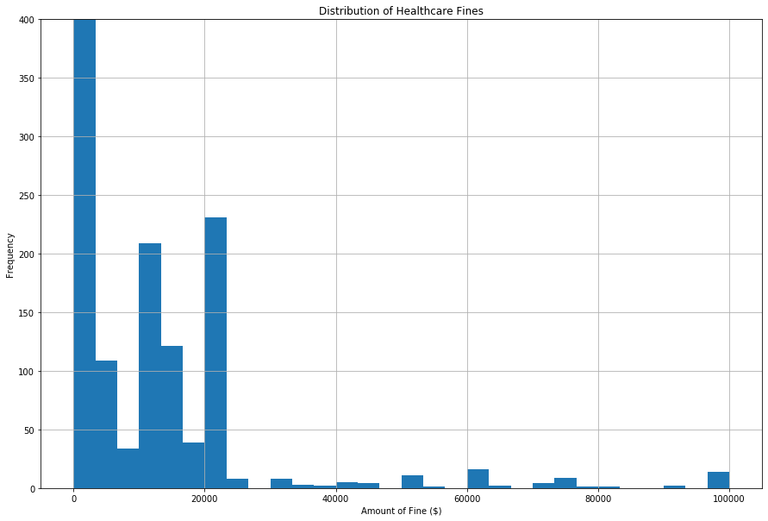
Distribution of fines
Almost all fines in the database were less than $20,000, with sharp peaks in frequency at round numbers like $1,000 and $5,000.
The highest fines were $100,000.
Approximately 2,000 of the 2,883 fines were $1,000 or less – the y-axis is artificially cut off at y = 400 in the graph on the right in order to better show variation in the rest of the population.

Slide 9
Frequency of common words
As shown in the graph on the next slide, the frequency of the most common words in the corpus declines exponentially, as predicted by Zipf’s Law.
Most of the words that appear very commonly are words that are not specific to any particular type of medical problem, e.g., “medication,” or “incident,” rather than “Lipitor” or “stroke.”
Two notable exceptions are “fall” and “blood.” This could be because those types of problems occurred more often, or it could be because many types of incidents involve some type of fall (perhaps as a side effect of an underlying problem) or some type of blood tests.

Slide 10
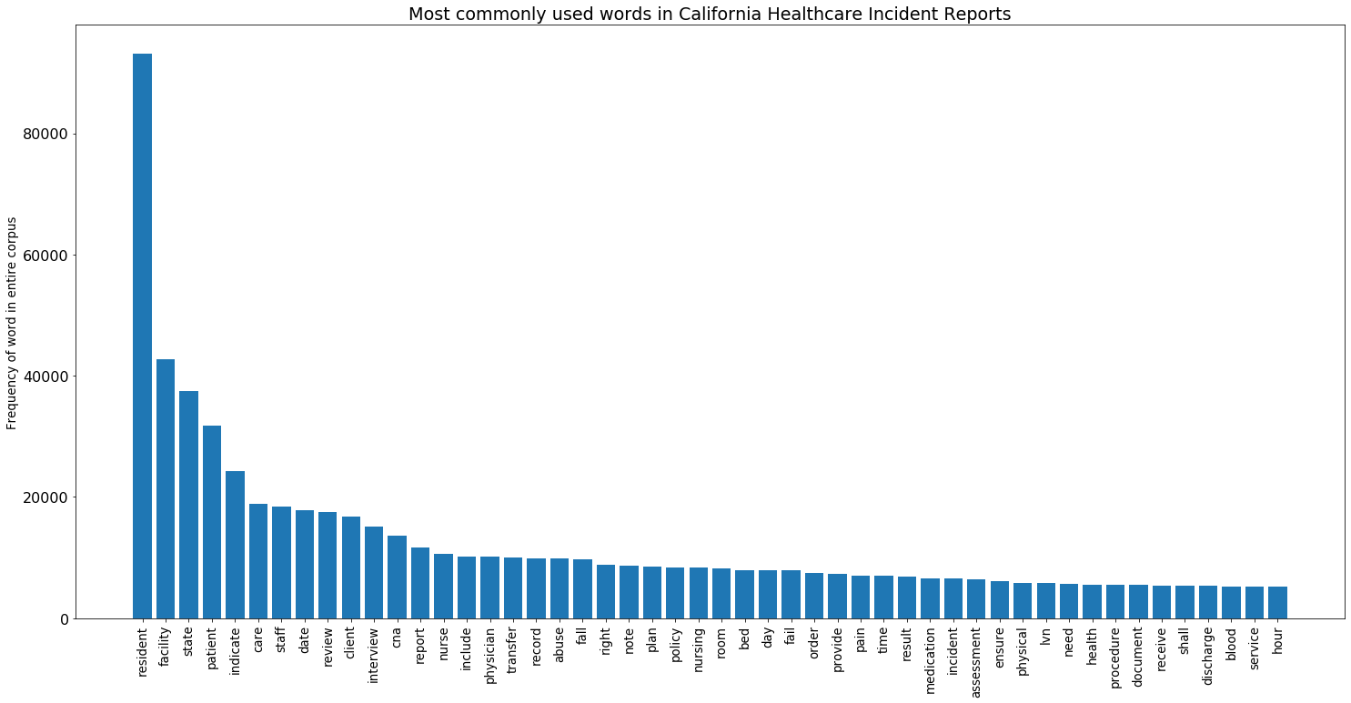
Commonly appearing words & phrases

Slide 11
Predicting the amount of fines

Slide 12
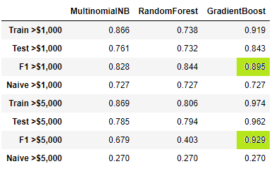
Categorical prediction
The categorical predictions attempted to guess whether each document had (a) a fine of over $1,000, and (b) a fine over $5,000.
The naive models always guess that the document is over each threshold. This means that the $1,000 threshold is an “easy” problem (because the naïve model is usually right), and the $5,000 threshold is a “hard” problem (because the naïve model is usually wrong).
The best-performing model was the Gradient Boosting Classifier, which achieved F1 scores of 0.895 and 0.929 on the two problems.
The Gradient Boosting Classifier correctly classified 96% of the fines over $5,000, compared to only 27% correct classifications in the naïve model.

Slide 13

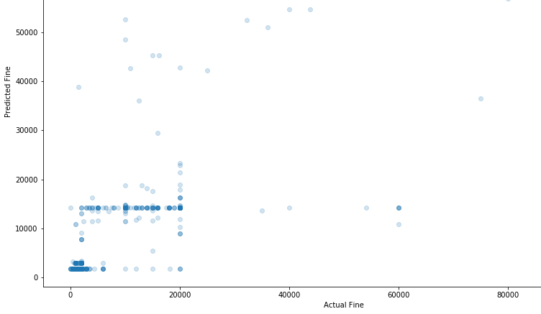
continuous prediction
Continuous fine estimates assign an actual dollar amount to each document, e.g., predicting that incident #345 will carry a fine of $2,000.
When predicting continuous fine amounts, the Random Forest Regressor out-performed the Gradient Boosting Machine.
The standard deviation of predicted fines was $8,218.
The predicted fines correlated with actual fines at r = 0.746.
In general, the continuous fine estimates would offer a useful guide, but not necessarily a reliable one.

Slide 14
Topic identification

Slide 15
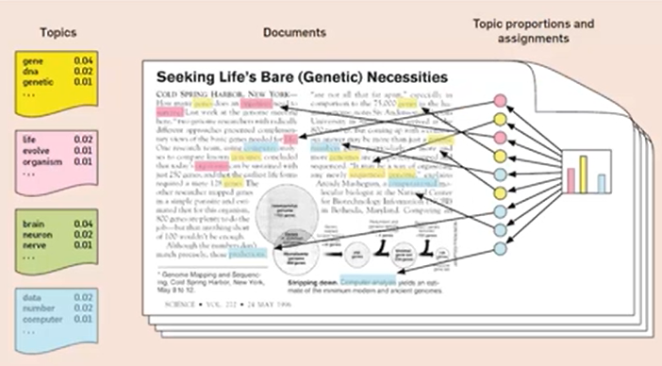
Latent Dirichlet allocation
Latent Dirichlet Allocation is a technique used to automatically propose a series of topics that apply to some of the documents in a corpus.
Each topic consists of several words, each of which is assigned to that topic with a particular strength. For example, in the model on the right, “brain” is associated with the green topic 4 times more strongly than “nerve.”
Each document can then be described as belonging to different topics with different strengths – in the example on the right, if a document contains mostly “blue” words, then it might be a document about computing. The colors are arbitrary and are used merely for illustration.
Image marked as licensed for noncommercial reuse by Choo, Lee, Reddy & Park.

Slide 16
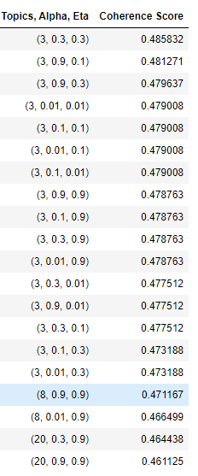
Tuning the hyperparameters
The Latent Dirichlet Allocation (LDA) Model can be tuned using many different hyperparameters, including:
the number of topics to be identified,
alpha (the strength of the prior distribution of topic assignments)
eta (the strength of the prior distribution of word assignments)
A set of hyperparameters can be evaluated using a coherence score, which assesses the degree to which the topics identified by the model have semantically similar key words. A higher score indicates that the topic is pointing to a real cluster of meaning in the English language, as opposed to a cluster of random words that happen to appear together in a particular corpus.
The coherence score changed very little as the hyperparameters varied, so I selected the highest-scoring set of hyperparameters (highlighted here in pale blue) that had more than 3 topics, because this allows for a subjectively more interesting set of topic assignments.

Slide 17
Selected Key words in each topic
Oxygen (0.6%)
Tube (0.5%)
Respiratory (0.3%)
CPR (0.3%)
Breathing (0.3%)
DCS (0.5%)
Sexual (0.3%)
Police (0.2%)
Disability (0.2%)
Yell (0.2%)
Account (1.8%)
Trust (1.2%)
Ad (0.7%)
Fund (0.7%)
Money (0.6%)
Temperature (0.6%)
Water (0.6%)
Degree (0.4%)
Burn (0.3%)
Hot (0.3%)
Wound (0.7%)
Ulcer (0.6%)
Sore (0.5%)
Pressure (0.4%)
Shower (0.2%)
Weight (0.6%)
Food (0.6%)
Diet (0.3%)
Source (0.2%)
Meal (0.2%)
Rash (1.1%)
Scabies (1.0%)
Outbreak (0.4%)
Cream (0.3%)
Itching (0.3%)
Sugar (0.8%)
Fluid (0.7%)
Insulin (0.6%)
Meal (0.4%)
Glucose (0.3%)

Slide 18
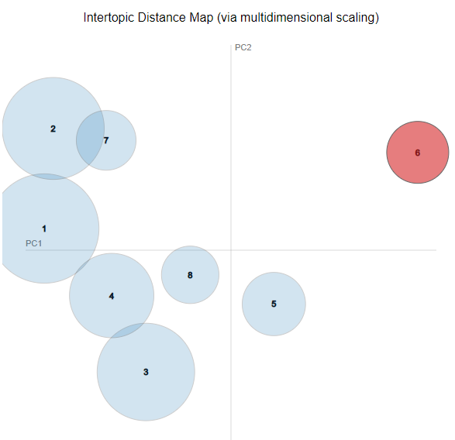
Principal component analysis of topic content
The eight topics shown on the previous slide were mapped onto an artificial two-dimensional grid created by principal component analysis.
The distance between each circle represents the average difference in semantic meaning between a pair of topics, so more similar topics are closer together.
The size of each circle represents its apparent ability to fully characterize the documents assigned to that topic – the larger the circle, the more the documents in that topic are composed of that topic’s keywords.
Although the x-axis and y-axis are artificial, in this case topics further to the right appear to be more financially related, and topics further to the top appear to be more related to emergencies and severe violations.

Slide 19
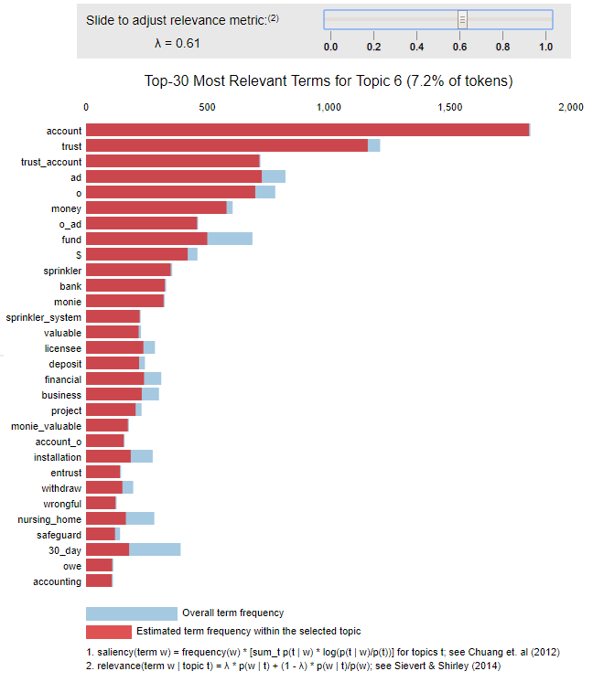
Interactive topic visualization
The visualization tool at the link below will allow users to interactively explore each topic.
https://nbviewer.jupyter.org/github/JGreenLowe/HealthEnforcement/blob/master/models/lda.html
The slider bar at the top of the tool lets users adjust how they define relevance: sliding the bar to the right shows the words in each topic with the highest total frequencies, and sliding the bar to the left shows the words that were most unique to each topic.
The fraction of each bar that is highlighted in red shows the extent to which a word’s appearances in the corpus are captured entirely within the documents assigned to a given topic.

Slide 20
Ethics and applications

Slide 21
Potential use cases
Medical directors – reduce the rate of serious health errors
Litigation directors – reduce liability for a hospital or nursing home
Insurance adjusters – set an appropriate fee for malpractice insurance
Defense attorneys – figure out which cases to settle and which cases to try in court
Government prosecutors – figure out which cases to investigate and prosecute for maximum deterrence

Slide 22
Ethical considerations
Problems
Solutions
Tools that can be used to minimize harms can be used just as easily to minimize fines while leaving harms untouched, weakening the effect of public health regulations.
Here the problem is not that the subject should not be studied (there are plenty of good reasons to study health care enforcement) or that the data is carrying racial biases (the fines are levied against hospitals, not against individuals), but that the subject matter is inherently prone to abuse.
Goodhart’s law claims that “any observed statistical regularity will tend to collapse once pressure is placed upon it for control purposes.” In other words, if people know exactly how fines are being applied, they can “game the system” by avoiding only the negligent behaviors that lead to large fines.
One way to try to cope with these issues is to encourage data scientists to ask pointed questions about the motivations for the studies they are engaged in. Is the purpose of a given project to promote pure knowledge, or to reduce medical injuries, or simply to evade fines? Data science in the public sector needs to carry not just a valid business justification, but also a valid public purpose.
Another way to try to cope with these issues is to encourage the regulators themselves to apply data science insights to issue fines on as broad and random of a basis as possible, so that even given perfect information about the regulators’ algorithm for assigning fines, the regulated entities will not be able to game the system except by providing perfect medical care. If the only way to beat the test is to make no serious errors, then attempting to reduce one’s fines to zero is praiseworthy, not selfish.

